Slide 1

Chronic Disease Challenges & Opportunities for Improvement
In Louisiana
May 5, 2017
Baton Rouge, Louisiana

Slide 2
Chronic Disease Burden
In 1987, chronic disease accounted for about two-thirds of total health care spending today it accounts for 86%.
Almost 90 cents of every $1 we spend on health care is associated with chronically ill patients
Nearly 70% of health care spending is linked to patients with 3 or more chronic conditions.
Over 35% of spending is associated with patients with 5 or more chronic conditions

Slide 3
Who is PFCD
The Partnership to Fight Chronic Disease (PFCD) is a global coalition of patient, provider, community, business and labor groups, and health policy experts, committed to raising awareness of the No. 1 cause of death, disability and rising health care costs: chronic disease.
OUR MISSION
EDUCATE the public about chronic disease and potential solutions for individuals and communities
MOBILIZE the public to call for change in how governments, employers, and health institutions approach chronic disease
CHALLENGE policymakers on the health policy changes that are necessary to effectively fight chronic disease

Slide 4
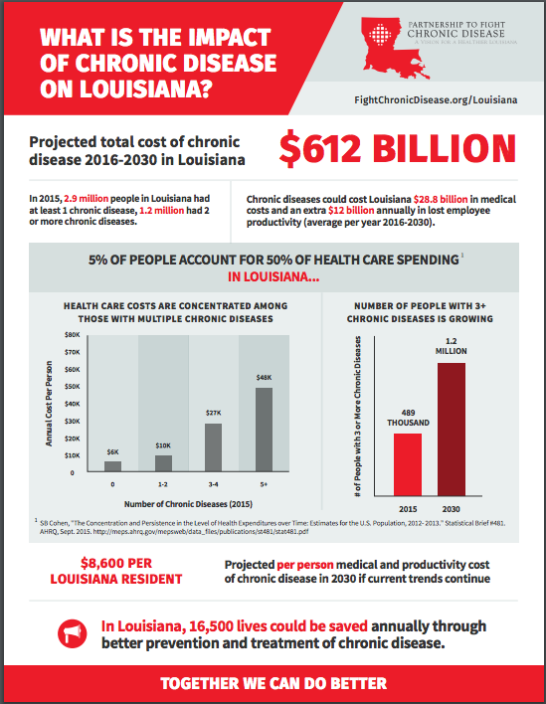
Louisiana’s Chronic Disease Burden
2.9 million people with at least one chronic condition;
1.2 million with 2 or more (and growing).
Economic losses of $12 BILLION a year in addition to medical costs.
Chronic diseases will cost $8,600 per resident a year without change.

Slide 5
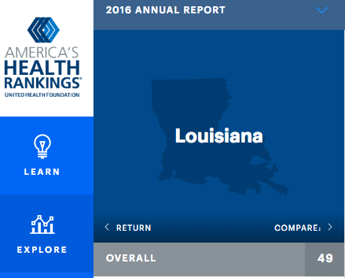
Chronic Disease Prevention
Highest burden of chronic disease shares FOUR COMMON Risk Factors:
Tobacco Use 43 out of 50
Excessive drinking 34 out of 50
Unhealthy eating 50 out of 50 (obesity)
Physical inactivity 45 out of 50
“80% OF PREMATURE HEART DISEASE, STROKE AND DIABETES CAN BE PREVENTED” – World Health Organization
Sources: WHO, Preventing Chronic Disease: A Vital Investment, http://www.who.int/chp/chronic_disease_report/full_report.pdf; America’s Health Rankings (2016), http://www.americashealthrankings.org/explore/2016-annual-report/measure/Overall/state/LA.

Slide 6
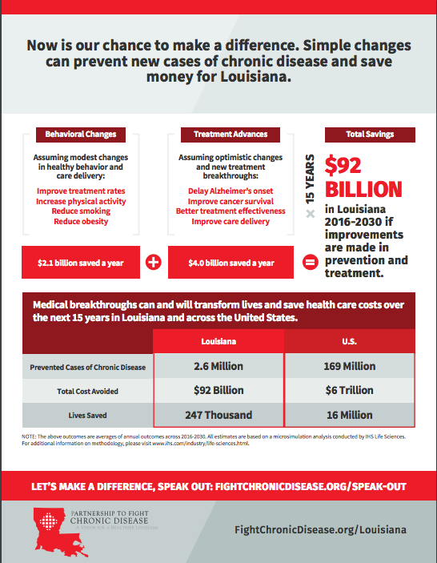
Louisiana’s Chronic Disease Opportunity
Potential To Save:
$92 Billion through 2030
347,000 people
Improvements Include:
Reduced smoking
Reduced obesity
Better access & adherence to treatment
Medical innovations to increase cancer survival & postpone

Slide 7
Louisiana’s Chronic Disease Opportunity
Potential To Save:
$92 Billion through 2030
347,000 people
Improvements Include:
Reduced smoking
Reduced obesity
Better access & adherence to treatment
Medical innovations to increase cancer survival & postpone

Slide 8
Identifying Near-Term Opportunities
Identify the “hot spots” – concentrations in costs provide opportunities for targeted efforts
Manage care transitions to lower readmissions
Better management of “ambulatory sensitive” conditions like diabetes, hypertension, asthma
  Self-management skill building
  Medication management
  Regular follow-up

Slide 9

Building on Existing Efforts
Improving access to quality care
  Medicaid expansion & enrollment
Enhancing access to patient-centered primary care
  Participation in Advanced Primary Care Practice Demonstration >> FQHCs meeting NCQA criteria of patient-centered medical homes
Joining larger initiatives
  Million Hearts Initiative: Cardiovascular Disease Risk Reduction
  TCPI: Consortium for Southeastern Hypertension Control

Slide 10
Building on Existing Efforts
Optimizing appropriate use of medications
  Louisiana Community Pharmacy Enhanced Services Network
Recognizing inter-relationships between health & determinants
  Department of Health & Housing Authority Permanent Supportive Housing

Slide 11
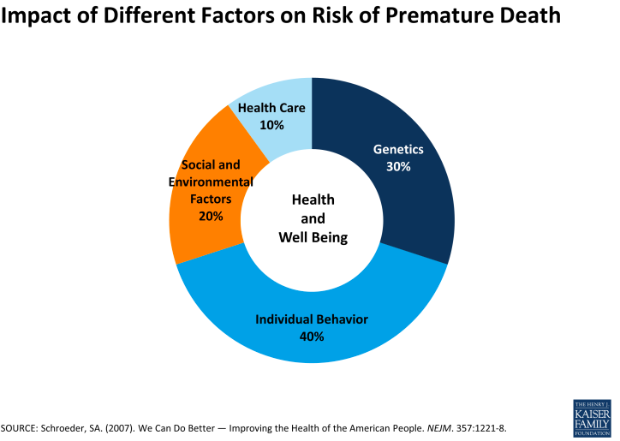
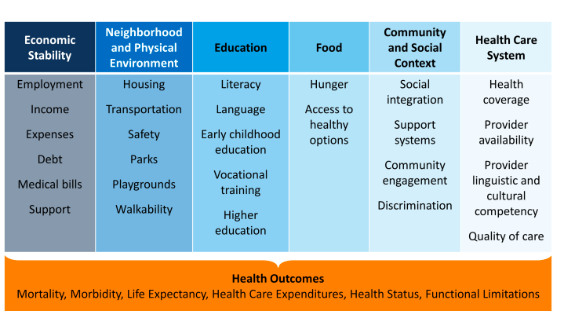
Inter-relationship with SDoH and Health
Health & Well-Being
Impact of Factors on
Risk of Premature Death

Slide 12
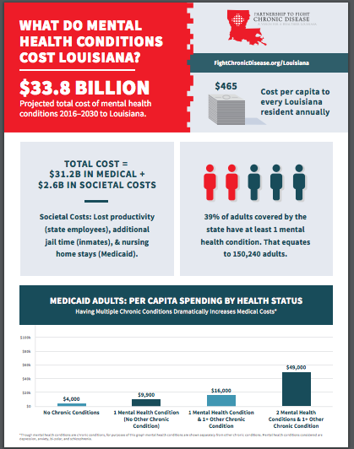
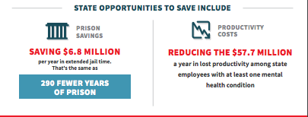
Louisiana’s Mental Health Burden

Slide 13

What’s next?
ACA & AHCA
  House set to vote on AHCA Thursday
  More Medicaid flexibility; less Medicaid funding
  Prevention Fund – cuts that support public health efforts
  Questions about Innovation Center
Subject to significant CHANGES in Senate.
Challenge of chronic disease remains.

Slide 14
Chronic Disease Challenges & Opportunities for Improvement
May 5, 2017
Baton Rouge, Louisiana

